Slide 1
Rounding decimals to significant figures
Estimation and rounding

Slide 2
how to use Oak lessons

Slide 3
I can round decimals to a required number of significant figures.

Slide 4
Significant figures are the digits in a number that contribute to the accuracy of the number. The first significant figure is the first non-zero digit.
Round − To change a number into another number that is approximately the same value but is easier to work with. E.g. Round 561 to the nearest 10 is 560.

Slide 5

Rounding decimals to significant figures
Using a number line
Rounding decimals to significant figures

Slide 6
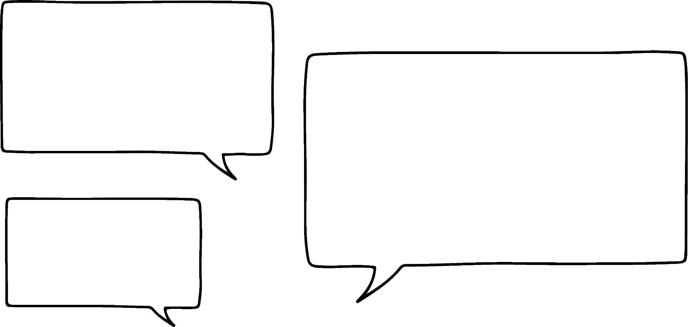
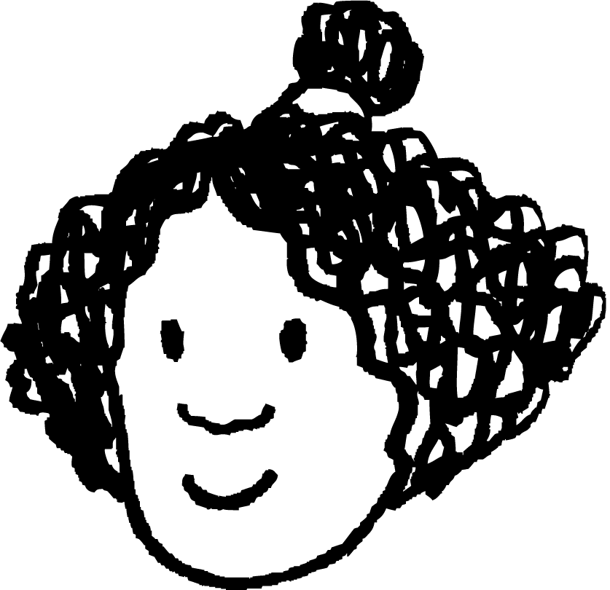

Using a number line
The average width of human hair is 0.009 cm.
Which digit is the most significant?
It tells us most about the size of the number.
Actually Alex, if you remember it was the first non-zero digit, not just the first digit. It isn’t really different.
When we rounded numbers larger than 1, the first digit was the most significant. Why has the rule changed now?
It is the 9. It is the only digit that tells us anything about the width of the hair.
Izzy
Why might Izzy say that?
Let’s take a look.
Alex

Slide 7











Using a number line
Oh yes, of course. We could write 60 as 0060 because there are no hundreds or thousands.
Yes, in numbers greater than one we can leave off the leading zeros.
But in numbers less than one we have to include the leading zeros.
We could write any number with zeros in the unused columns.
HMn | TMn | Mn | HTh | TTh | Th | H | T | O | T | H | Th | TTh
 |  | 0 | 0 | 0 | 0 | 0 | 6 | 0
th
th
th
th
Izzy
Alex
.
.
the first non-zero digit

Slide 8
Using a number line
When rounding to significant figures, the first significant figure is the first non-zero digit in a number.
E.g. 0.00483 The 4 is the first significant figure.
0.083904 The 8 is the first significant figure.
1.00398 The 1 is the first significant figure.
0.00023 The 2 is the first significant figure.
310.952 The 3 is the first significant figure.

Slide 9

Using a number line
In which of the following is 4 the first significant figure?
0.0245
0.0000492
0.00458
0.0000645

Slide 10
Using a number line
What is 0.123 rounded to one significant figure?
HMn | TMn | Mn | HTh | TTh | Th | H | T | O | T | H | Th | TTh
 |  |  |  |  |  |  |  | 0 | 1 | 2 | 3
th
th
th
th
.
.
first significant figure
not significant
The first significant figure is in the tenths column.
Therefore, we round to the nearest tenth.
0.123
0.1
0.15
0.2
0.123 = 0.1 (to 1 s.f.)

Slide 11
Using a number line
What is 0.0068 rounded to one significant figure?
HMn | TMn | Mn | HTh | TTh | Th | H | T | O | T | H | Th | TTh
 |  |  |  |  |  |  |  | 0 | 0 | 0 | 6 | 8
th
th
th
th
.
.
not significant
first significant figure
not significant
not significant
The first significant figure is in the thousandths column.
Therefore, we round to the nearest thousandth.
0.0068
0.006
0.0065
0.007
0.0068 = 0.007 (to 1 s.f.)

Slide 12
Using a number line
What is 0.096 to one significant figure?
HMn | TMn | Mn | HTh | TTh | Th | H | T | O | T | H | Th | TTh
 |  |  |  |  |  |  |  | 0 | 0 | 9 | 6
th
th
th
th
.
.
1st significant figure
not significant
not significant
The first significant figure is in the hundredths column.
Therefore, we round to the nearest hundredth.
0.096
0.09
0.095
0.1
0.096 = 0.1 (to 1 s.f.)

Slide 13
Using a number line
What is 10.392 to three significant figures?
HMn | TMn | Mn | HTh | TTh | Th | H | T | O | T | H | Th | TTh
 |  |  |  |  |  |  | 1 | 0 | 3 | 9 | 2
th
th
th
th
.
.
1st significant figure
3rd significant figure
2nd significant figure
The third significant figure is in the tenths column.
Therefore, we round to the nearest tenth.
10.392
10.3
10.35
10.4
10.392 = 10.4 (to 3 s.f.)

Slide 14
Using a number line
Which of the following are correctly rounded to one significant figure?
0.27 = 0 (to 1 s.f.)
0.026803 = 0.03 (to 1 s.f.)
28.00985 = 28 (to 1 s.f.)
0.00002503 = 0.00003 (to 1 s.f.)

Slide 15
Using a number line
Underline the first significant figure in each of the following:
0.0040
0.569
0.000000500002
110.00382
9872.00000600845
0.010260323

Slide 16
Using a number line
2) Match the following to the correct number rounded to one significant figure:
0.0001492
0.001
0.0971
0.01
0.001093
0.1
0.0095028
0.0001

Slide 17
Using a number line
3) Round each of the following to the number of significant figures given in the brackets.
a) 0.00087 = (1 s.f.)
b) 234.0284 = (2 s.f.)
c) 0.82384 = (3 s.f.)
d) 1006.00321 = (2 s.f.)
e) 0.009602 = (1 s.f.)
f) 0.0237952 = (4 s.f.)

Slide 18
Using a number line
Underline the first significant figure in each of the following:
0.0040
0.569
0.000000500002
110.00382
9872.00000600845
0.010260323

Slide 19
Using a number line
2) Match the following to the correct number rounded to one significant figure:
0.0001492
0.001
0.0971
0.01
0.001093
0.1
0.0095028
0.0001

Slide 20
Using a number line
3) Round each of the following to the number of significant figures given in the brackets.
a) 0.00087 = 0.0009 (1 s.f.)
b) 234.0284 = 230 (2 s.f.)
c) 0.82384 = 0.824 (3 s.f.)
d) 1006.00321 = 1000 (2 s.f.)
e) 0.009602 = 0.01 (1 s.f.)
f) 0.0237952 = 0.02380 (4 s.f.)

Slide 21
Rounding decimals to significant figures
Using a number line
Rounding decimals to significant figures

Slide 22
Rounding decimals to significant figures
Round 0.000642 to two significant figures.
HMn | TMn | Mn | HTh | TTh | Th | H | T | O | T | H | Th | TTh | HTh | Mh
 |  |  |  |  |  |  |  | 0 | 0 | 0 | 0 | 6 | 4 | 2
.
th
th
th
th
th
th
.
1st s.f.
2nd s.f.
2 is less than 5
The second significant figure is in the hundred thousandths column.
Therefore, we round to the nearest hundred thousandth.
Therefore, the digit in the hundred thousandths column stays the same.
0.000642 = 0.00064 (2 s.f.)

Slide 23
Rounding decimals to significant figures
Round 0.000095 to one significant figure.
HMn | TMn | Mn | HTh | TTh | Th | H | T | O | T | H | Th | TTh | HTh | Mh
 |  |  |  |  |  |  |  | 0 | 0 | 0 | 0 | 0 | 9 | 5
.
th
th
th
th
th
th
.
1st s.f.
exactly halfway
The first significant figure is in the hundred thousandths column.
Therefore, we round to the nearest hundred thousandth.
Therefore, we increase the digit in the hundred thousandths column by 1.
0.000095 = 0.0001 (1 s.f.)

Slide 24
Rounding decimals to significant figures
Round 0.06076 to three significant figures.
HMn | TMn | Mn | HTh | TTh | Th | H | T | O | T | H | Th | TTh | HTh | Mh
 |  |  |  |  |  |  |  | 0 | 0 | 6 | 0 | 7 | 6
.
th
th
th
th
th
th
.
1st s.f.
2nd s.f.
3rd s.f.
6 is greater than 5
The third significant figure is in the ten thousandths column.
Therefore, we round to the nearest ten thousandth.
Therefore, the digit in the ten thousandths column increases by 1.
0.06076 = 0.0608 (3 s.f.)
Notice that the zero between 6 and 7 is significant.

Slide 25
Rounding decimals to significant figures
Izzy and Alex are rounding 0.00300858 to 3 significant figures.
Who is right?
What mistake has the other person made?
I think it is 0.00301
It is 0.0030086
Izzy has forgotten that the zeros after the first significant figure are significant.
The zero in the hundred thousandths column is the third significant figure.
Izzy
Alex

Slide 26
Rounding decimals to significant figures
Rounding decimals to significant figures
Rounding decimals to significant figures
Round each of the following to the given number of significant figures (s.f.) and find them in the number grid.
1 s.f.
0.0428
0.00068
546.483
0.000072
0.00087
0.684
2 s.f.
0.00427
0.000423
0.517
0.609
1.359
0.00322
0.00000731
0.007178
0.45563
0.0001605
81 503.24
0 | . | 0 | 0 | 4 | 3 | 0 | . | 0 | 9 | 3 | 0
. | 1 | . | 6 | 7 | 0 | . | 0 | 5 | 9 | . | .
0 | . | 0 | 0 | 7 | 2 | 5 | 8 | 2 | 0 | 0 | 0
0 | . | 0 | 0 | 0 | 4 | 2 | 7 | 4 | 3 | . | 0
0 | 2 | 0 | 8 | . | 4 | 0 | . | 0 | 0 | 0 | 9
7 | . | 1 | 2 | 0 | 9 | . | 0 | . | 9 | 0 | 0
0 | . | 6 | 1 | 0 | . | 0 | 3 | 8 | 0 | . | 6
3 | 2 | 0 | 3 | 7 | 2 | 0 | 7 | 2 | . | 4 | 2
0 | . | 0 | 0 | 3 | 2 | 0 | . | 9 | 0 | 6 | 5
4 | 7 | 9 | 0 | 4 | . | 0 | 3 | 8 | 6 | 2 | .
. | 3 | 4 | 9 | 0 | . | 7 | . | 1 | 0 | 3 | 8
1 | 2 | 0 | . | 0 | 0 | 0 | 0 | 0 | 7 | 3 | 4
3 s.f.
0.9058
0.06329
0.06069
0.8287
0.009064

Slide 27
Rounding decimals to significant figures
Round each of the following to the given number of significant figures (s.f.) and find them in the number grid.
1 s.f.
0.0428
0.00068
546.483
0.000072
0.00087
0.684
2 s.f.
0.00427
0.000423
0.517
0.609
1.359
0.00322
3 s.f.
0.9058
0.06329
0.06069
0.8287
0.009064
0.00000731
0.007178
0.45563
0.0001605
81 503.24
0.04
0.0007
500
0.00007
0.0009
0.7
0.0043
0.00042
0.52
0.61
1.4
0.0032
0.0000073
0.0072
0.46
0.00016
82 000
0.906
0.0633
0.0607
0.829
0.00906

Slide 28
Rounding decimals to significant figures
Round each of the following to the given number of significant figures (s.f.) and find them in the number grid.
1 s.f.
0.0428
0.00068
546.483
0.000072
0.00087
0.684
2 s.f.
0.00427
0.000423
0.517
0.609
1.359
0.00322
0.00000731
0.007178
0.45563
0.0001605
81 503.24
0 | . | 0 | 0 | 4 | 3 | 0 | . | 0 | 9 | 3 | 0
. | 1 | . | 6 | 7 | 0 | . | 0 | 5 | 9 | . | .
0 | . | 0 | 0 | 7 | 2 | 5 | 8 | 2 | 0 | 0 | 0
0 | . | 0 | 0 | 0 | 4 | 2 | 7 | 4 | 3 | . | 0
0 | 2 | 0 | 8 | . | 4 | 0 | . | 0 | 0 | 0 | 9
7 | . | 1 | 2 | 0 | 9 | . | 0 | . | 9 | 0 | 0
0 | . | 6 | 1 | 0 | . | 0 | 3 | 8 | 0 | . | 6
3 | 2 | 0 | 3 | 7 | 2 | 0 | 7 | 2 | . | 4 | 2
0 | . | 0 | 0 | 3 | 2 | 0 | . | 9 | 0 | 6 | 5
4 | 7 | 9 | 0 | 4 | . | 0 | 3 | 8 | 6 | 2 | .
. | 3 | 4 | 9 | 0 | . | 7 | . | 1 | 0 | 3 | 8
1 | 2 | 0 | . | 0 | 0 | 0 | 0 | 0 | 7 | 3 | 4
3 s.f.
0.9058
0.06329
0.06069
0.8287
0.009064

Slide 29
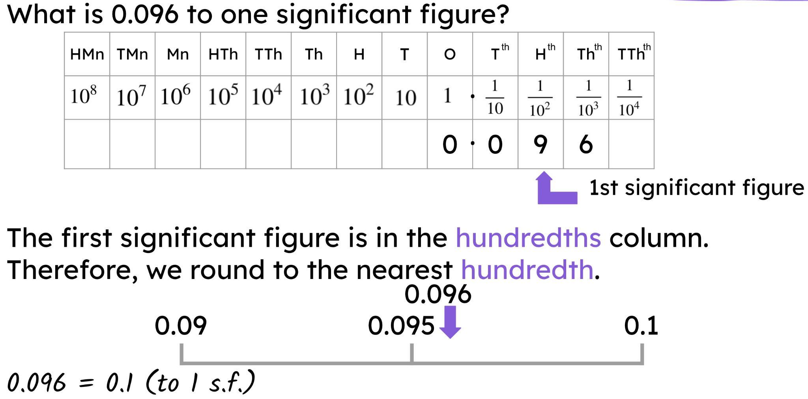
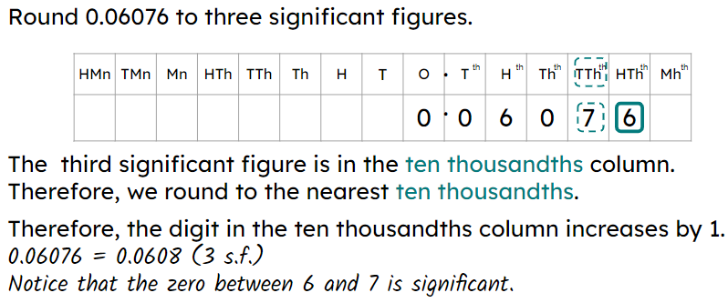
Rounding decimals to significant figures
The first significant figure is the first non-zero digit.
Zeros after the first significant figure are significant.
A number line is useful when rounding decimals to significant figures.
E.g.
A place value chart is useful when rounding decimals to significant figures.
E.g.

Slide 30

© Oak National Academy 2024.
Produced in partnership with Mathematics in Education and Industry.
Licensed on the Open Government Licence v3.0, except where otherwise stated. See Oak terms and conditions.

